Slide 1
Shell Bootcamp 2024 3 Reflections for Week 3
Anisha Sharma
Date : 13-Sept-2024

Slide 2

About Me
‘According to me’ is the only ‘according to’ that matters

Slide 3

My learnings from this week!

Slide 4
Learning 1 | My takeaways
We learnt about ERP and SAP modules.
Key learning: Evolution and history of Enterprise resource planning. SAP architecture, modules and their project implementations.
Key takeaway: ERP helps in integrating multiple business models. SAP have different types of projects, and we use ABAP programming language to implement features in SAP.
We also studies about the roles of ABAPers in real time.

Slide 5
Learning 2 | My takeaways
Hands on ABAP, Data Dictionary and R/3 Tier Architecture.
Key learning: Different operations, datatypes, and keywords of ABAP language. DDIC which is basically used to create and alter the tables.
Key takeaway: ABAP is not case sensitive, but it is space sensitive. And we create a package to transfer our code. SAP is database independent, so it does not support SQL instead it supports OpenSQL.
R/3 Tier Architecture is used in SAP which has 3 layers i.e. Presentation, Application and Database layer.

Slide 6
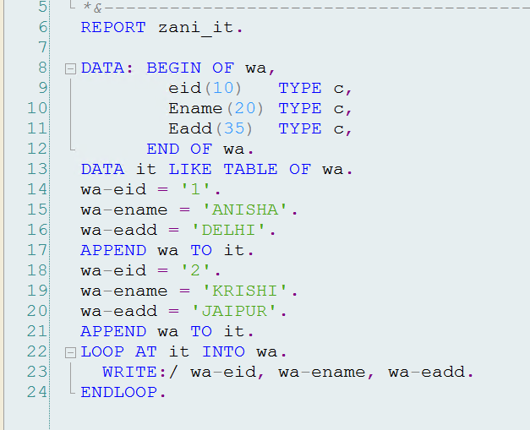
Learning 3 | My takeaways
Index, Database Table, Internal Table and Structure
Key learning: There are Primary and Secondary Index. Internal table is the collection of records. Structure is the data object stored one after the other component.
Key takeaway: There can be maximum 16 Primary and 9 Secondary fields in a table. Database must contain at least 1 field as primary field. Structure does not contain any data.
Internal tables are temporary that means they won’t save anywhere in SAP.

Slide 7

Relevance of learnings for my organization

Slide 8
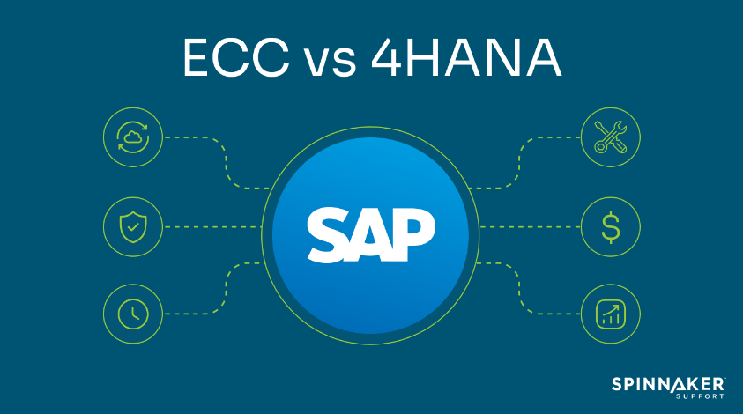
Learning 1 | Relevance for Shell
Shell has a complex ERP landscape with multiple SAP systems, including SAP ECC 6 and SAP S/4HANA1.
ABAP is used extensively in SAP for custom development. ABAPers play a vital role in implementing new features, customizing existing functionalities, and ensuring that the SAP systems meets Shell’s specific requirements.
Shell is undergoing a significant transformation to SAP S/4HANA, which involves multiple projects and phases

Slide 9
Learning 2 | Relevance for Shell
Understanding the operations, datatypes, and keywords of ABAP is essential for developing custom solutions within Shell’s SAP environment.
Creating packages to transfer code is vital for deploying changes and updates in a controlled manner.
The DDIC is crucial for creating and managing database objects like tables, views, and structures. At Shell, this knowledge helps in maintaining the integrity and consistency of data across various SAP models.

Slide 10
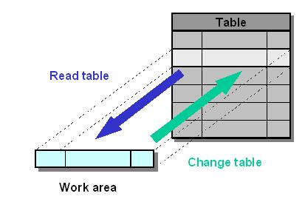
Learning 3 | Relevance for Shell
At Shell, Primary and Secondary fields helps maintain accurate and consistent data across various SAP modules. At Shell, internal tables are essential for processing large volumes of data efficiently during runtime without affecting the database.

Slide 11

Challenges in implementing learning

Slide 12
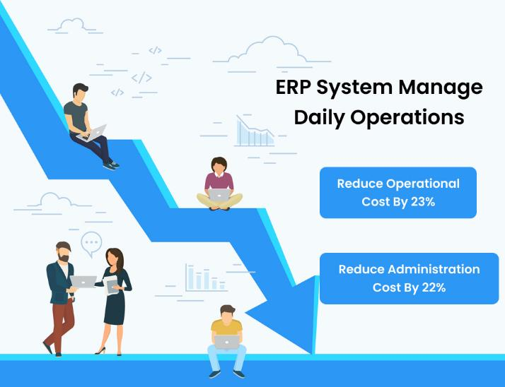
Challenge faced while implementing Learning 1
Understanding the intricate details of how ERP systems integrate various business models can be overwhelming due to the vast amount of information and the technical depth required.
SAP consists of numerous modules, each with its own set of functionalities and processes. Learning the specifics of each module and how they interconnect requires significant effort and time.

Slide 13
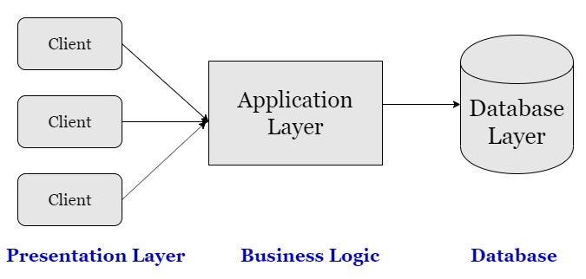
Challenge faced while implementing Learning 2
Grasping the nuances of ABAP, especially its space sensitivity, can be tricky.
Mastering DDIC involves understanding how to create and alter tables, which can be complex due to the need for precise definitions and relationships between data objects.
In R/3 architecture comprehending the three layers (Presentation, Application, and Database) and how they interact can be complex.

Slide 14
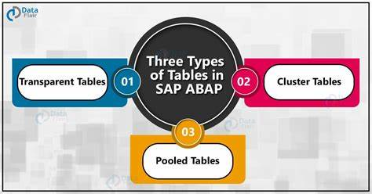
Challenge faced while implementing Learning 3
Proper usage of Primary and Secondary Indexes can be difficult, especially when dealing with large datasets and ensuring optimal performance.
Grasping how internal tables work, including their temporary nature and how they are used to manipulate data during runtime, can be challenging without hands-on experience.
Since internal tables do not save data permanently, understanding their lifecycle and how to effectively use them for temporary data storage and processing can be challenging.

Slide 15

Action Plan

Slide 16
My Action Plan for this Week
Actions
Timeline
Status
Interacting with my peers from.
Participated in the group discussions.
Kept learning new topics
ERP, SAP, Coding in ABAP, DDIC, R/3 Tier Architecture
Ended the week by learning so many new topics regarding my line of business.

Slide 17

Learning is also Fun!

Slide 18
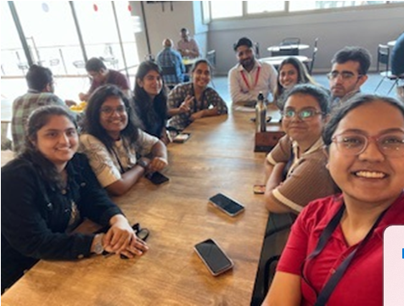
Learning is also Fun!
We learned a lot of technical topics related to our line of business. Our facilitator is amazing. He even took us for lunch. The way he teaches is commendable, feels like everything gets imbibed inside the brain. He focuses so much on practical knowledge that we don’t to revise anything. The hands-on experience before working on the tech stacks made us comfortable with the environment.

Slide 19

Summary
Learned ERP, SAP, ABAP.
S/4 HANA, BTP and selection screens.
Migrating from ABAP to HANA.

Slide 20
Thank You

